Slide 1
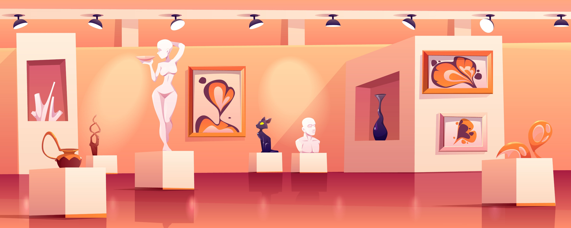
TALKING CHALKS
Domiziana Catalano Edoardo Puglisi Gianluca Panici

Slide 2
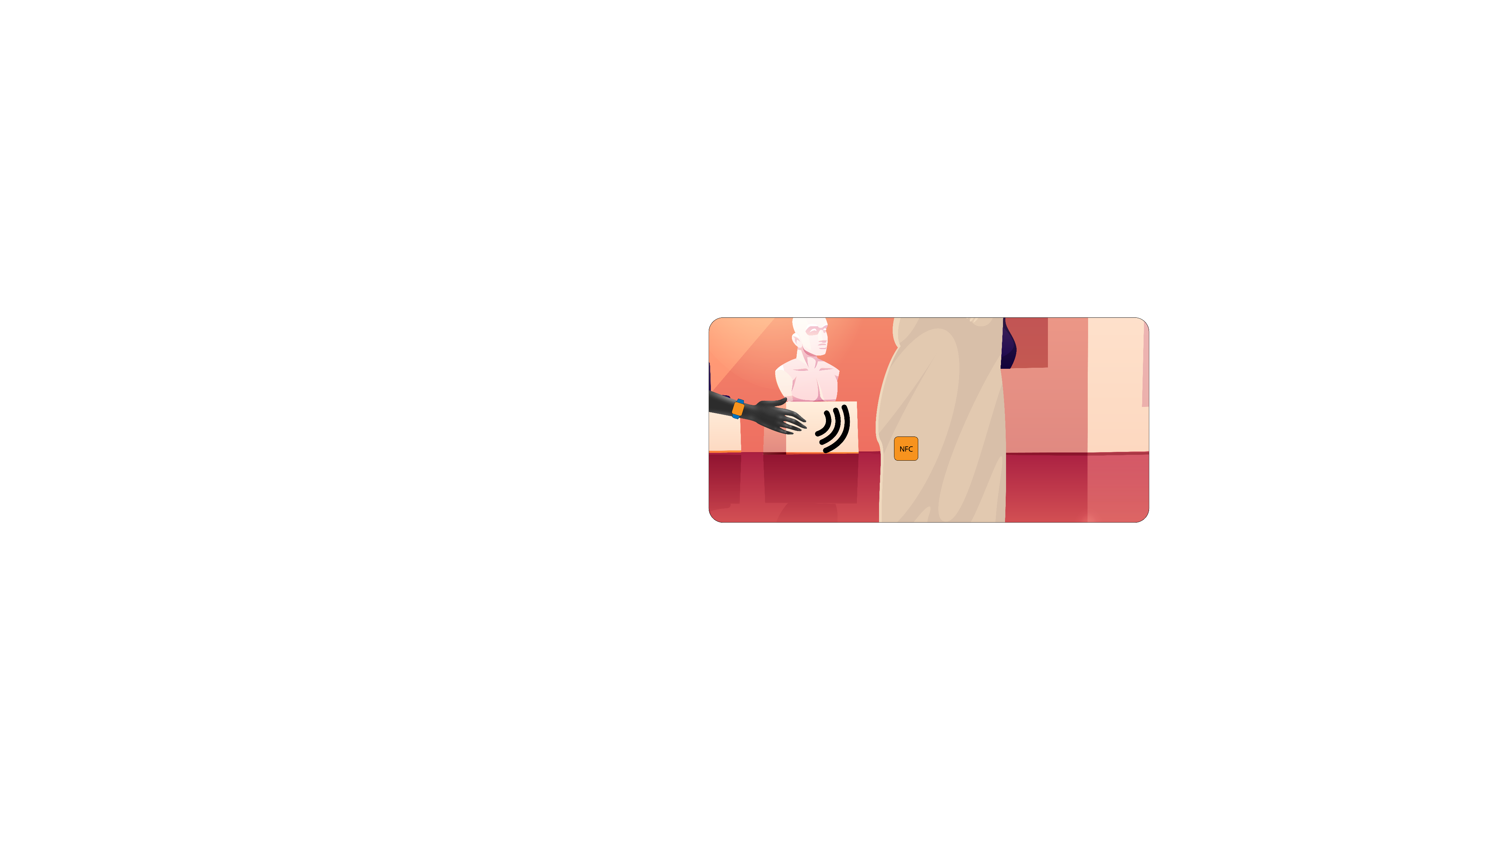
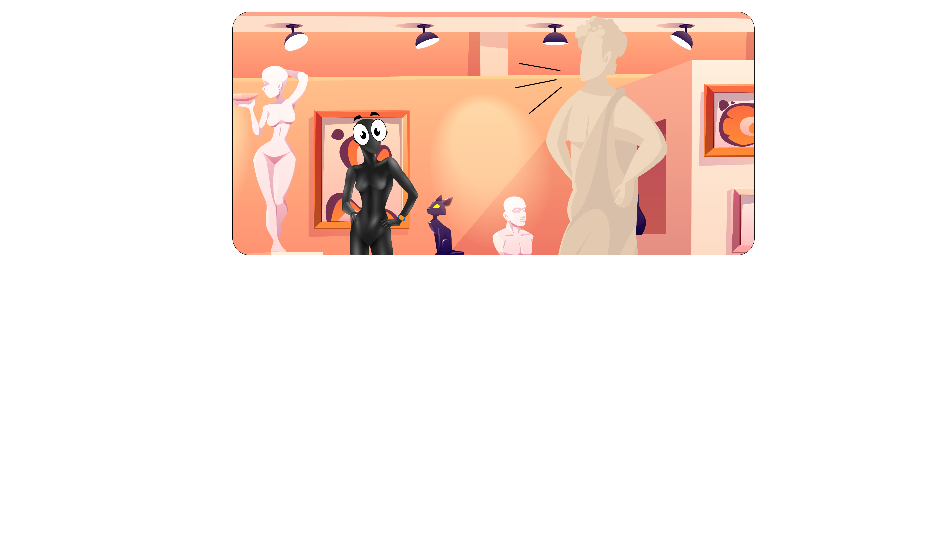
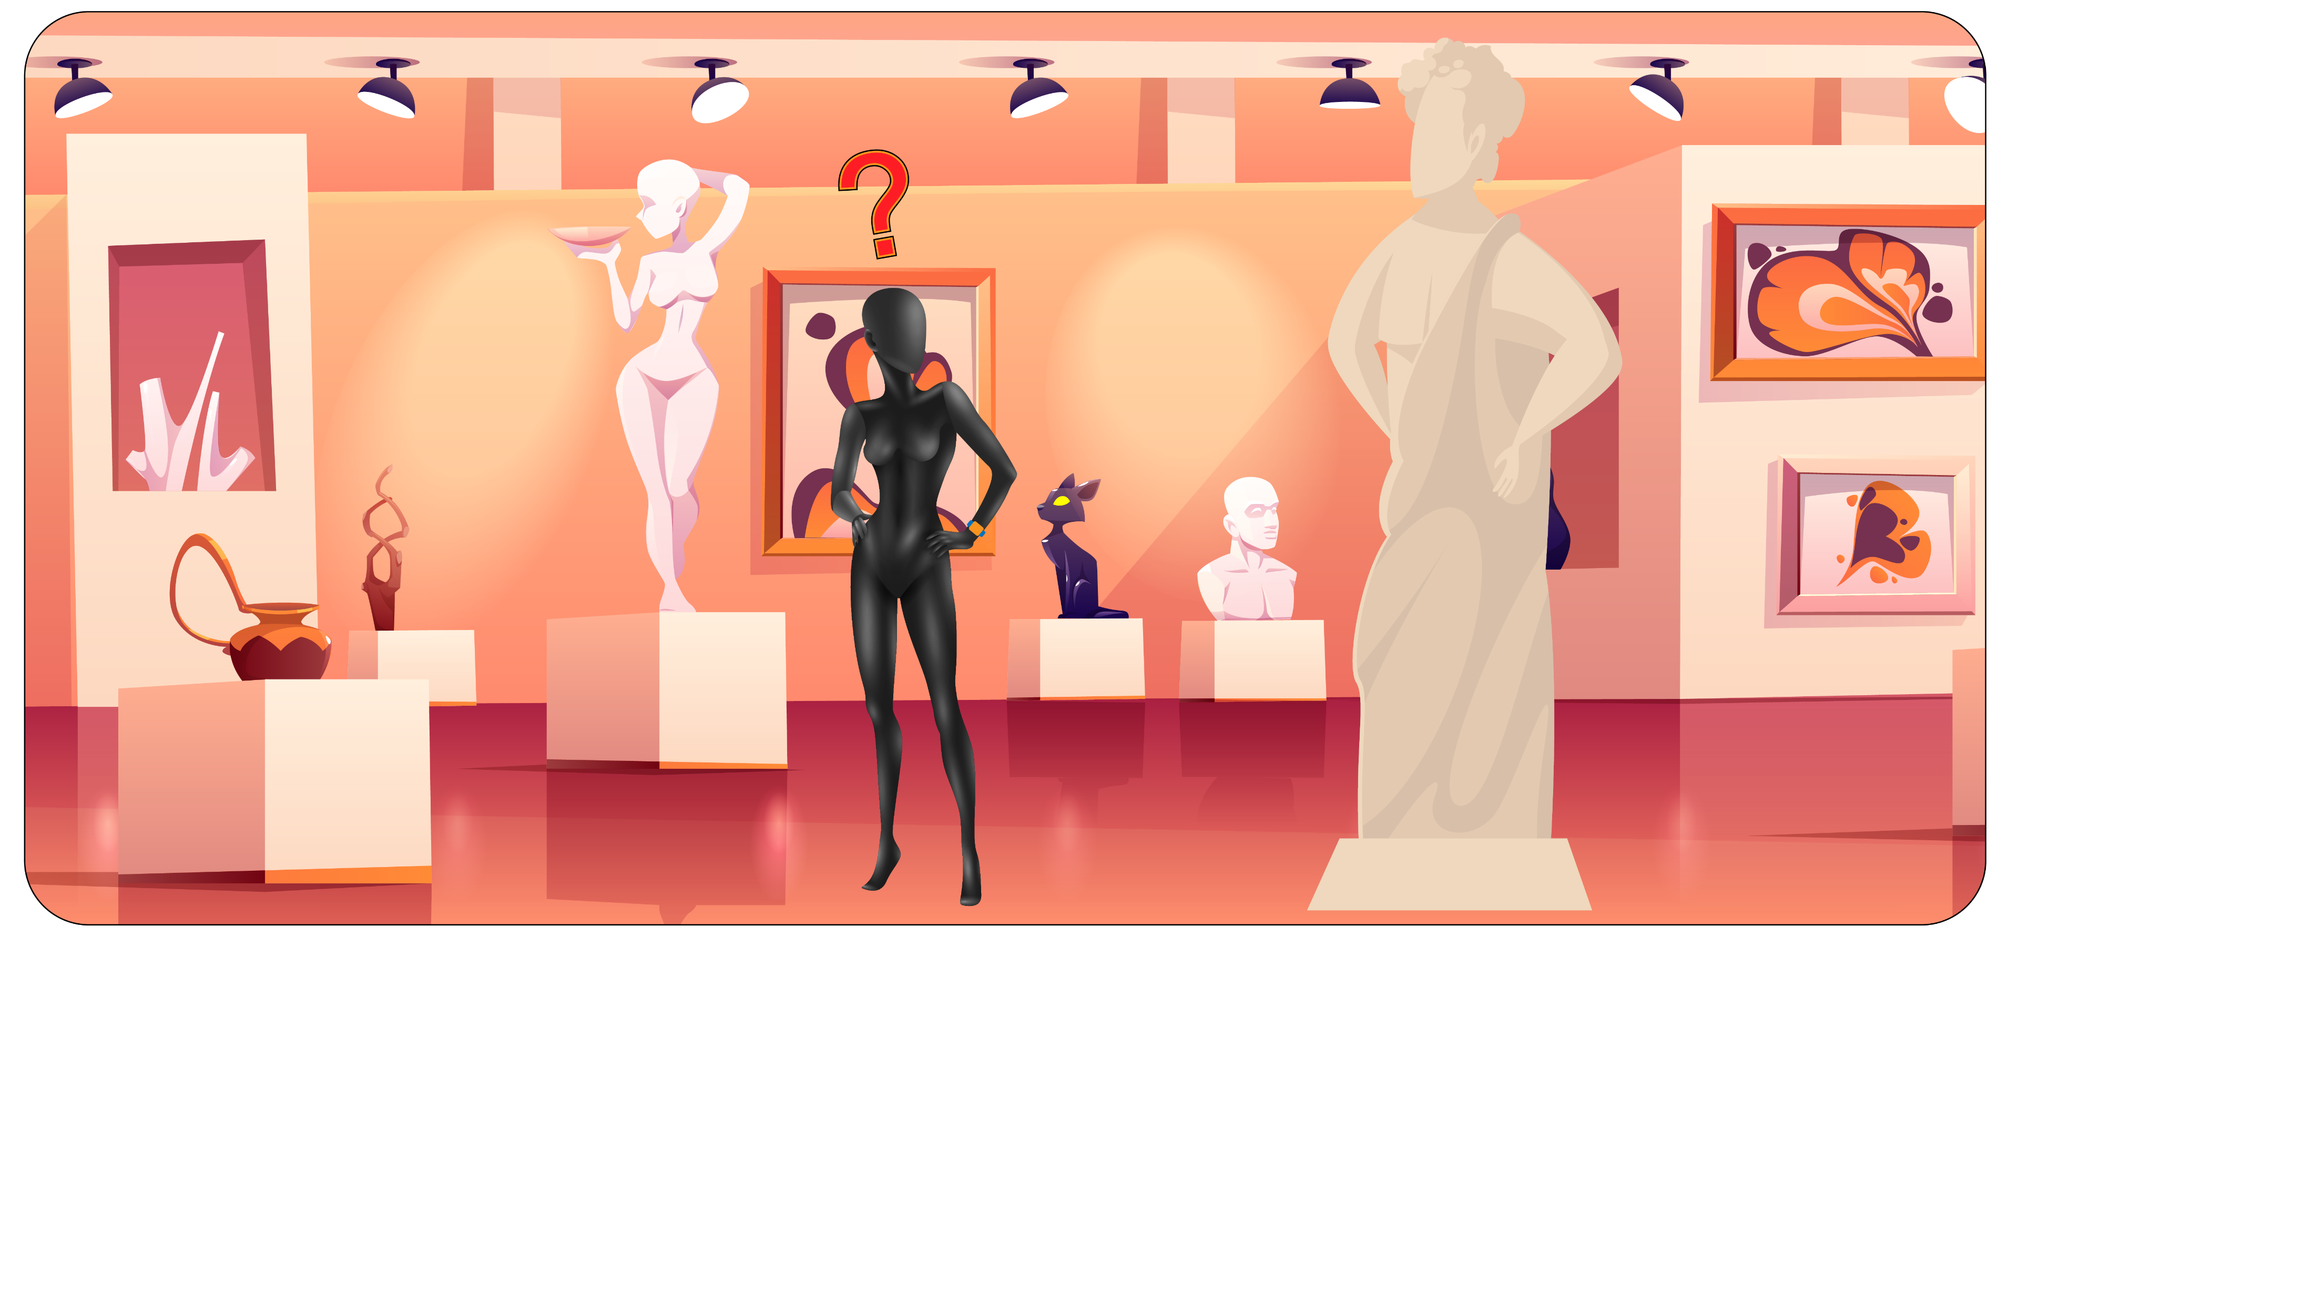
PROBLEM AND SOLUTION
This was an explicit request from
Curators of Museum
Visitor happy and stoned hearing talking figures
New amazing technology comes to help him
Visitor confused and afraid of his ignorance

Slide 3
TALKING CHALKS
Domiziana Catalano Edoardo Puglisi Gianluca Panici

Slide 4
COMPETITORS
KEY POINTS
CUSTOM TOUR – visitors can choose what kind of experience they want from the tour.
EASY/READY-TO-USE – just wear our band and enjoy the tour, that´s it! No smartphone or internet connection required, your grandpa won´t bother you anymore.
TRUSTED INFO – description are curated directly from the museum organization.
SCALABILITY – both for users and developers.
DATA – curators can understand which are the most visited statues of the museum and arrange tours according to this
Service | Fast | Free | High Quality of information | Customized info | Full immersion on the tour
TalkingChalks | ✅ | ✅ | ✅ | ✅ | ✅
Audio Guide | ✅ |  | ✅
Museum Guide |  |  | ✅ | ✅
Internet |  | ✅

Slide 5
TALKING CHALKS
Domiziana Catalano Edoardo Puglisi Gianluca Panici

Slide 6
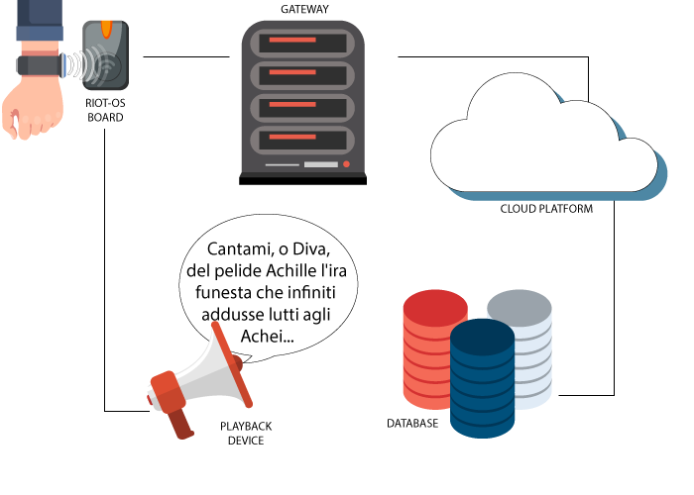

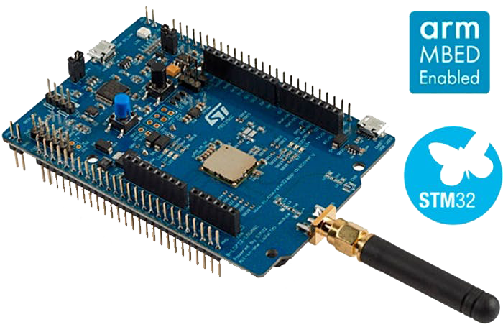

ARCHITECTURE
Riot-OS STM Nucleo Board with NFC/BEACON sensor
Gateway to the Cloud
Playback device for the customized experience
Cloud service for scaling
Database recording visitor presences
AZURE CLOUD SERVICES
Azure provides many out-of-the-box services that can be easily interconnected such as Cosmos DB: a multi-model database service for any scale. It guarantees a global distribution, high-availability and low latency. Messages that arrive at the hub are stored so that museum curators can access them and have a whole vision of user’s interactions.
Strenghts:
Secure: no sensitive data stored
Easy to use – Easy API
Always reachable
Scalability
BOARD
NFC SENSOR – to retrieve user’s details (tour category, HR) to be sent to the gateway.
LoRa Connector – transmitter needed to use the LoRaWan Connection Protocol.
Strenghts:
Easy to use – RiotOS based
Secure: no access to sensitive data of the user.
SMARTBAND
NFC TAG – to send user’s details (tour category, HR) to the boards (and then to the gateway).
HR Sensor – dedicated to the retrieval of user’s HR. The board will send the heart rate pick of the last few seconds to better recognize user’s emotion.
Strenghts:
Easy to use – User only need to scan the NFC tag with it.
Ready to use – just wear it!
Secure: no access to sensitive data of the user.

Slide 7
TALKING CHALKS
Domiziana Catalano Edoardo Puglisi Gianluca Panici

Slide 8
SCALABILITY
FOR USERS
Thanks to smart-bands, new features can be implemented.
We can build up an user tracking infrastructure, implement health-safety system, new solutions for smart donations and founding.
Everything is possible with the technologies we have chosen.
SCALABILITY
FOR DEVELOPERS
Not only end user parts of the application are important, but also maintenance and code easiness: cause of our scalability purposes, the main word of our coding style is malleability.
Our code is designed to be quickly updated and modified. It is also ready to go out from TTN if needed.
With few commands it is ready to be tested and debugged.
We made it, you will use it, everyone will be able to repair it.

Slide 9
TALKING CHALKS
Domiziana Catalano Edoardo Puglisi Gianluca Panici

Slide 10

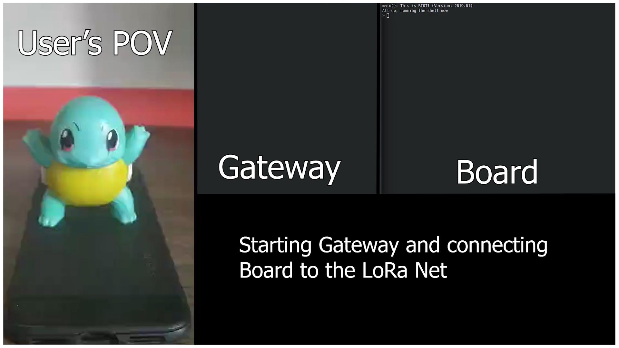
FINAL DEMO
Demonstration of TalkingChalks both from the visitor’s point of view and curator/developer’s one.
LoRa Board + Playback device simulated by a smartphone, while two different smartband´s profiles by two NFC tags. Squirtle as “Love and Psyche¨.

Slide 11

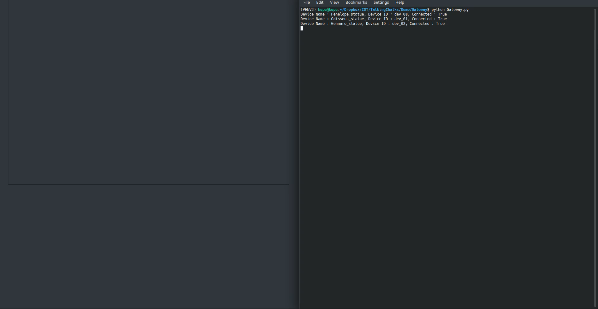
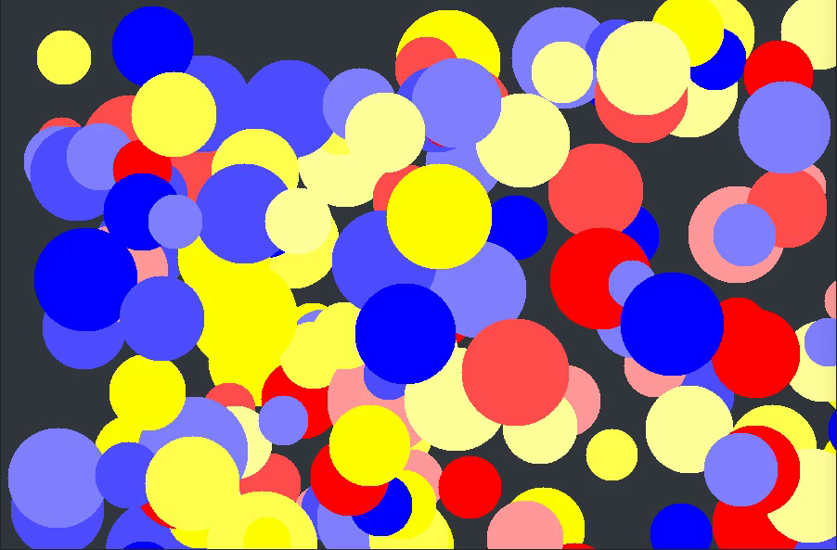
NEW FEATURES
“Physiological Correlates of Aesthetic Perception of Artworks in a Museum” research paper from American Psychological Association reveals that artworks may elicit emotional and physiological responses and we tried too collect this kind of data.
Smartband now collects also the heart rate of the person who wears it to recognize if the sculture is appreciated or not and how much.
THE MASTERPIECE
The artwork can be generated whenever the curator want (every day/month/year) and is fully customizable due to the fact that is a function of visitors’ interaction.
Circles can be replaced with different kind of shapes and every user’s category can be represented with its own color.
VISITORS’ CONTRIBUTION
As anticipated in previous delivery we wanted to put the user in the center of the art and for this purpose we found a way to generate an abstract artwork using visitors’ interactions with the statues.
In this experiment also heart rate plays a crucial role displaying how much a specific user-category participated emotionally to the artwork.

Slide 12
DASHBOARD
To ease museum curator’s job we also deployed a basic webapp in which they can monitor statue’s “accesses” from each category of users.

Slide 13
THANKS FOR WATCHING
Domiziana Catalano Edoardo Puglisi Gianluca Panici

